Slide 1
nozama

Slide 2
01
Company Overview
02
Statistics
03
The Business Problem
04
From a Data Science Perspective
Contents
05
Our Solution
06
Metrics and Baseline
07
Model Deployment
08
Business Impact

Slide 3


The Company
Business Model
Product and Service
B2C & B2B: Operates a third-party seller marketplace while also curating its own private-label products. Revenue comes from sales commissions, a premium membership (nozama Select), advertising, and AI-driven retail analytics for businesses.
E-commerce platform and delivery service, specialising in user-driven commerce. Shoppers actively shape product offerings through reviews, recommendations, and direct suggestions.
1
1
3
2
Mission
4
nozama’s Vision
2
We strive to empower our customers to shape the marketplace by turning their feedback into action, offering curated selections, dynamic pricing, and personalized experiences based on real user insight
4
3
To be the world’s most community-driven commerce platform, where customer voices directly influence what gets made, sold, and celebrated

Slide 4


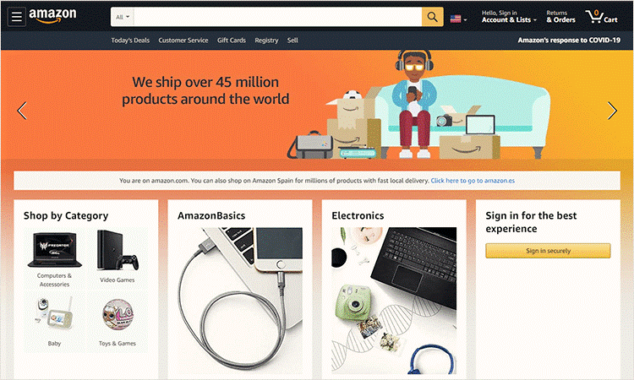


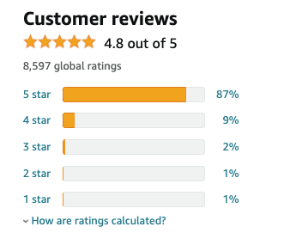

Statistics
20+
12m+
COUNTRIES
PRODUCTS
Headquarters in Berlin Major offices in Berlin, London, Milan, New York, Tokyo, and Sydney.
nozama’s community-driven marketplace features 12M+ products, from electronics to creator-led brands, with dynamic listings shaped by demand, trends, and reviews.
148m+
70%
Select
SELECT® USERS
CUSTOMER TRUST
The introduction of nozama Select in 2015 expanded the company’s horizons, offering personalised product bundles, early-access deals, and premium customer support.
Internal analysis indicates that up to 70% of user trust erosion is linked to exposure to manipulated or suspicious reviews. The rise of AI-generated fake content has made it harder for customers to distinguish authentic feedback from spam or bias.

Slide 5
The Business Problem
As a platform shaped by user-generated content, nozama depends on reviews to guide product visibility, customer decisions, and seller success. However, the rise of AI-generated fake reviews has severely undermined customer trust and the platform’s integrity. The main business consequences being:
Erosion of Trust in Review Credibility
Customers increasingly question the reliability of reviews, affecting engagement and confidence in product recommendations.
Distorted Purchase Signals & Biased Algorithms
Fake reviews artificially inflate product rankings, compromising search relevance, recommendation quality, and inventory prioritization
Operational Cost of Manual Moderation
Fake reviews are flagged, stretching the capacity of trust & safety teams, increasing moderation overhead (costly and unscalable)
Brand Risk and Seller Inequity
Sellers relying on organic, high-quality reviews are at a disadvantage against competitors using synthetic boosting tactics.

Slide 6


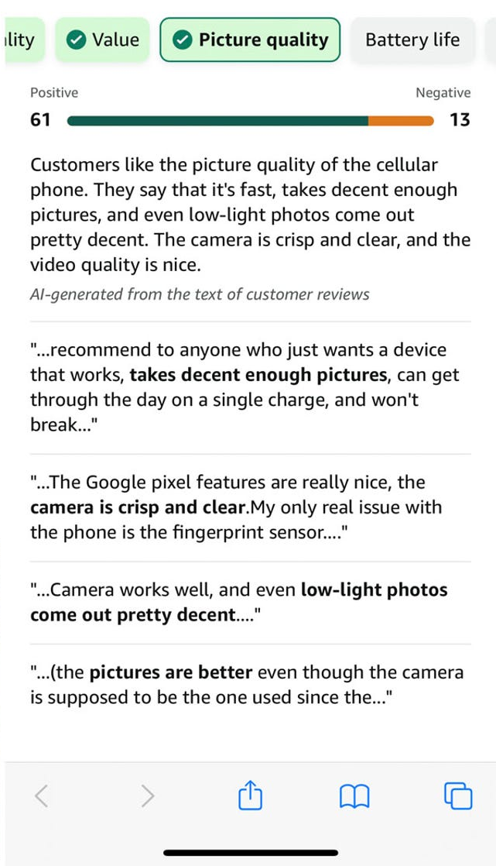

From a Data Science Perspective
To address the erosion of trust caused by fake reviews, we need to develop a robust binary classification model capable of distinguishing between authentic, human-written reviews and AI-generated fake reviews.
Task type: NLP
Input: Review Text
Output: Binary Label
CG
Computer (AI) Generated
OR
Original Reviews
Challenges
Textual ambiguity: AI-generated reviews are often grammatically correct and well-structured, making them hard to distinguish with simple models or rule-based filters.
High linguistic overlap: Many fake reviews mimic the sentiment and tone of real reviews, requiring a model to detect subtle patterns.
Goal
Automatically flag suspicious reviews using machine learning, enhancing nozama’s ability to:
• Preserve platform credibility
• Support fair competition among sellers
• Protect customers from deceptive purchase influence

Slide 7
Our Solution
Hypothesis
Specific textual elements, indicative of fake reviews fabrication, exist. Those elements can be assessed through a text mining approach by analysing
Grammatical elements
Sentiment
Sentence elements
Fake reviews often exhibit unnatural grammatical patterns, such as a higher frequency of adjectives or overly formal constructions.
Fake reviews tend to exhibit polarized sentiment—either overly positive to boost a product or exaggeratedly negative for review bombing.
CG reviews might differ in sentence structure and punctuation used
Sentence length
Punctuation frequency
Special characters frequency
Uppercase word ratio
POS tagging
Syntactic tag density
Sentiment BERT model

Slide 8
Baseline Model
Objective: Establish a simple benchmark for fake review detection → a reference point to assess the performance of more sophisticated ML models
Model Logic
Assumption
Rule
Binary classifier based on the hypothesis that text length is a proxy for distinguishing between human-written and AI-generated reviews
Computer-generated reviews tend to be shorter and more templated, while human reviews vary more in length
Reviews shorter than the threshold are predicted as fake (CG)
Reviews longer than the threshold are predicted as original (OR)
Performance Accuracy
Model ~55.1%
Random prediction ~50%
Predicting most frequent class ~50%
Simple heuristics can capture weak patterns in the data—but there is the need for more robust, feature-rich model

Slide 9
Model deployment
Preprocessing & Feature Engineering Pipeline
• Load reviews dataset
• Extract POS and syntactic tags, sentiment score, sentence element features
Model Training & Evaluation
• Training the model on labelled data & evaluated
• Model is stored into .pkl format
Batch Model Deployment
• Batch prediction on collected reviews
• Outputs the binary predictions of the trained model
Model Destination
• Dashboard and KPI monitoring
New, unlabelled data is pre-processed
Why batch prediction
The rate at which new reviews are submitted does not justify the expenses of a real-time prediction stream
A larger number of reviews can be collected during the day, and batches ran overnight/daily, yielding higher efficiency

Slide 10
Handover
Main components
feature_engineering.py
Automates extraction of linguistic, structural, and sentiment features from new review data.
train.py
Trains and serializes the binary classification model using labelled reviews and engineered features.
inference.py
Runs batch predictions on newly submitted reviews using the trained model and outputs classification results.
Steps
Update the model
For Continuity
Collect reviews (user submissions)
Preprocess & feature engineer new reviews using feature_engineering.py.
Run inference on the processed data using inference.py (trained model is loaded automatically).
Use predictions for moderation, dashboarding, or integration into internal tools.
Retrain every N weeks with newly labelled reviews
Use as labelled reviews those flagged and verified by moderators
Update and version model artifacts in GCS
Automate the workflow using:
Orchestrators: Trigger the feature engineering script and set up the following pipeline steps through GC Workflows.
Schedulers: Enable time-based automation to batch-predict regularly

Slide 11





Business Impact
+13%
Customer Trust
Customers can trust reviews, resulting in higher engagement and conversion rates
+28%
Fake Review Detection
By having trustworthy reviews customers are more likely to remain loyal customers
-40%
Moderation Costs
By automating the fake reviews flagging, the manual costs are reduced
+2%
Conversion Rates
Higher confidence in reviews are more likely to convert into sales and ensures stronger credibility for the platform
-50%
Customer Dispute Cases
By flagging and removing reviews will reduce fraud activity and ensure platform fairness
Dashboard

Slide 12
thanks!

